Slide 1
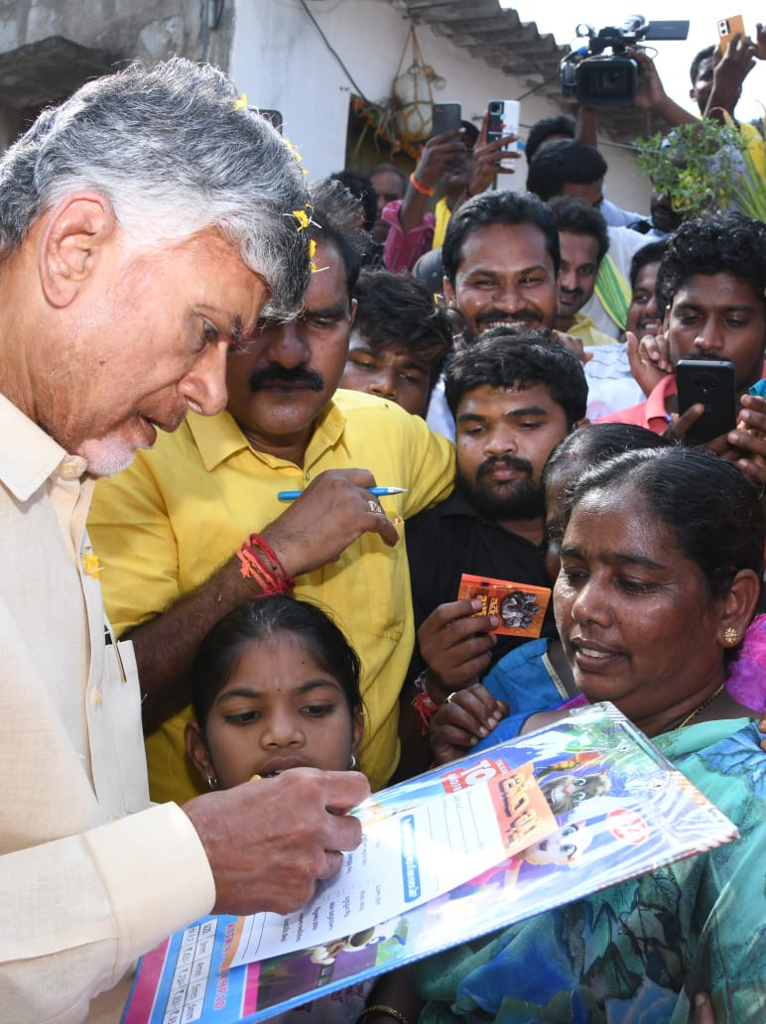

Training to Surveyors
Unified Family Survey
16/17th December

Slide 2




Objectives of Unified Family Survey
Collection of data required by departments for policymaking
Enabling proactive delivery of benefits & services (Category B to Category A)
Improving saturation and quality of data in the RTGS data lake

Slide 3






Design principles of Unified Family Survey
  Dedicated mobile application for the survey
  Coverage of 100% citizens with e-KYC
  Auto-population of data till extent possible
  Validation of data by document verification wherever possible
  Consent for survey by any adult household member

Slide 4
Survey aims to capture both Individual and family level attributes
Individual level Questions
A
Basic Profile
B
Social Profile
C
Education & Skilling
D
Employment & Livelihood
Family level Questions

Slide 5
Survey aims to capture both Individual and family level attributes
Individual level Questions
SN | Question | Auto-populated (Yes, No, Yes & Editable) | Pre-population sources / Validations / Remarks
1 | Enter Aadhaar of the surveyee* | Yes & Editable | - Pre-populated from GSWS - Editable only through Aadhaar e-KYC - If age < 6, capture Sishu Aadhaar
2 | Enter the name of the surveyee* | Yes & Editable | - Pre-populated from GSWS - Editable only through Aadhaar e-KYC
3 | Select the gender of the surveyee* | Yes & Editable | - Pre-populated from GSWS - Editable only through Aadhaar e-KYC
4 | Enter the date of birth of the surveyee* | Yes & Editable | - Pre-populated from GSWS - Editable only through Aadhaar e-KYC
5a | Do you have dedicated mobile number* | Yes & Editable | - Self reported
5b | Enter the mobile number of the surveyee | Yes & Editable | - Pre-populated from GSWS - Valid only if response to Q5a is “Yes” - One mobile number can only be used for one citizen & should be validated via OTP
6 | How long have you been residing in Andhra Pradesh?* | No | - Validate with birth certificate, RC, Aadhaar, property tax, Capture ID of sources, if available
A
Basic Profile
B
Social Profile
C
Education & Skilling
D
Employment & Livelihood
Family level Questions

Slide 6
Survey aims to capture both Individual and family level attributes
Individual level Questions
SN | Question | Auto-populated (Yes, No, Yes & Editable) | Pre-population sources / Validations / remarks
7 | Select the current marital status of the surveyee* | Yes & Editable | - Pre-populated from Marriage/Divorce certificate - Validate through RC, Marriage/Divorce certificate for married/divorced citizens - Capture ID of above sources, if available
8a | Select Father or Husband Name of surveyee? | Yes & Editable | - Prepopulated from GSWS - Validate through 10th class marksheet, Passport, Birth Certificate, Voter ID, Ration Card, Marriage certificate, Aadhaar - Capture ID of above sources, if available - For all male: Father name - For female (unmarried/ divorced/ seperated): Father name - For female (married/widowed): Husband name
8b | Enter Father or Husband Aadhaar number* | Yes & Editable | - Prepopulated from GSWS if the member exists in the same household - Perform Aadhaar eKYC If member doesn’t exists in same household
A
Basic Profile
B
Social Profile
C
Education & Skilling
D
Employment & Livelihood
Family level Questions

Slide 7
Survey aims to capture both Individual and family level attributes
Individual level Questions
SN | Question | Auto-populated (Yes, No, Yes & Editable) | Pre-population sources / Validations / remarks
9a | Select the caste category of the surveyee* | Yes & Editable | - Prepopulated from integrated certificate (direct and derived) - Verify from available certificate or TC in case the claimed caste and prepopulated caste is different - Capture ID of above sources, if available
9b | Select the caste of the surveyee* | Yes & Editable
10 | Select the religion of the respondent* | Yes & Editable | - Prepopulate from GSWS DB
A
Basic Profile
B
Social Profile
C
Education & Skilling
D
Employment & Livelihood
Family level Questions

Slide 8
Survey aims to capture both Individual and family level attributes
Individual level Questions
SN | Question | Auto-populated (Yes, No, Yes & Editable) | Pre-population sources / Validations / Remarks
11a | Are you currently pursuing any education?* | No | - Validate through admission letter/Student ID card - Capture APAR ID
11b | What education are you currently pursuing? | No
11c | Enter the place where respondent has been studying | No
12a | What is the highest level of formal education completed?* | Yes & Editable | - Pre-populated from GSWS database - Validate through mark-sheet/degree
12b | Are you a dropout from college?* | No | - Validate through admission letter/Student ID card
13a | Have you undergone any skill training?* | No | - Validate through certifications
13b | What type of skill training have you taken? | No
A
Basic Profile
B
Social Profile
C
Education & Skilling
D
Employment & Livelihood
Family level Questions

Slide 9
Survey aims to capture both Individual and family level attributes
Individual level Questions
SN | Question | Auto-populated (Yes, No, Yes & Editable) | Pre-population sources / Validations / Remarks
14a | What is/are your main source/s of income (Occupation/s)?* | Yes & Editable | - Pre-populated from GSWS database - Verify through, MGNREGA card, ID cards - Capture ID of above sources, if available
14b | Are you self-employed?* | No | - Self-reported
14c | What is your average monthly income (INR)?* | No | - Validate through Income Certificate if available - Capture ID of above sources, if available
15 | Do you migrate seasonally for work (Intra-state migration)?* | No | - Self-reported
A
Basic Profile
B
Social Profile
C
Education & Skilling
D
Employment & Livelihood
Family level Questions

Slide 10
Survey aims to capture both Individual and family level attributes
Individual level Questions
SN | Question | Auto-populated (Yes, No, Yes & Editable) | Pre-population sources / Validations / Remarks
16 | Enter Household ID (HHID)* | Yes | - Pre-populated from GSWS database
17a | Are all citizens consistently mapped with Household* | No | - Required to capture the wrong mapping in Households - Self reported
17b | Select the citizen which is inconsistently mapped*
17c | Select reason for inconsistent mapping
18a | Enter the current address (including District, Mandal, Constituency, and Secretariat)* | Yes & Editable | - Pre-populated from GSWS database - Dynamic data point and part of basic citizen profile - Validated through Aadhaar, Passport, Driving license, Residence certificate, Gas bill, Current bill - Capture ID of above sources, if available
18b | Permanent Household address* (including District, Mandal, Constituency, and Secretariat) | No | - Validated through Aadhaar, Passport, Driving license, Residence certificate, Gas bill, Current bill - Capture ID of above sources, if available
18c | Enter Door number of the household | Yes & Editable | - Pre-populated from PR&RD database
18d | Capture geo-coordinates* | No | NA
A
Basic Profile
B
Social Profile
C
Education & Skilling
D
Employment & Livelihood
Family level Questions

Slide 11
Survey aims to capture both Individual and family level attributes
Individual level Questions
SN | Question | Auto-populated (Yes, No, Yes & Editable) | Pre-population sources / Validations / Remarks
19a1 | Select type of roof of the house where the household is living* | No | - Validated through surveyor
19a2 | Are you living in a rented/own house?* | No | - If rented, validated through any reliable sources like rental agreement - If own house, capture property tax number
19b | Is there a water tap connection available in the household?* |  | - Validate through water bill receipt - Capture water bill receipt number
19c | Do you have access to LPG? |  | - Validate through LPG customer ID - Capture LPG customer ID
19d | Do you have access to Wifi? |  | - Validate through wifi connection number - Capture Wifi connection number
19e | Do you have access to mobile phone? |  | NA
19f | Do you have access to electricity? |  | - Capture Service Connection number
19g | Do you have access to toilet? |  | - Validate through surveyor
A
Basic Profile
B
Social Profile
C
Education & Skilling
D
Employment & Livelihood
Family level Questions

Slide 12
Survey aims to capture both Individual and family level attributes
Individual level Questions
SN | Question | Auto-populated (Yes, No, Yes & Editable) | Pre-population sources / Validations / Remarks
20a | Select the electronic assets the household possesses* | No | - Validated through surveyor
20b1 | Select the vehicular assets the household possesses*
20b2 | Capture Registration Number of Vehicle*
20b2 | Select the name of citizen against whom Vehicle is registered*
20c | Select the farm machinery assets the household possesses*
20d | Select the animal husbandry assets that the household possesses and their number*
20e | Select the miscellaneous assets that the household possesses*
A
Basic Profile
B
Social Profile
C
Education & Skilling
D
Employment & Livelihood
Family level Questions

Slide 13
Timelines for Unified Family Survey
Survey Timelines
SN | Particular | Owner | Timeline
1 | Training of surveyors | Master Trainers | 16-17th Dec
2 | Commencement of survey | GSWS | 15th Dec
3 | Review & Monitoring | GSWS, RTGS | Daily
WhatsApp group will be created to ensure smooth communication and timely issue resolution during the survey

Slide 14

Thank You

