Slide 1
Scheme Eligibility Parameters
S.No | Department | Type | Parameter
1 | DISCOMS | Consumption of Electricity | The monthly Electricity utilization (own or rented house) be less than 300 units/month for the household (the average consumption of electricity of 12 months will be taken into consideration
2 | Civil Supplies | Rice Card | Atleast one person in the household should possess a Rice Card
3 |  | Total Household Income | Should not exceed 10,000 per month in rural areas and 12,000 Per month in urban areas
4 | Revenue | Total Land Holding of Household | Should be less than 3 acres of wet land or less than 10 acres of dry land or less than 10 acres of both combined together.
5 | Transport | Four-Wheeler | Anyone amopng the household memebers if owing a 4-wheeler (Taxi, Tractors, Autos are exempted) is not eligible.
6 | MUAD | Municipal Property | The household should not own any municipal property which is 1000 sq.ft and above.
7 | Finance | Government Employee/Pensioner | Any on eamong the household members employed in any Central/State Government Service/PSU or getting Govt.Pension (Post Retirement) are not eligible (Sanitation Workers are exempted and all employees getting less than Rs 10,000/- salary per month in Rural and less than Rs 12000/- per month in urban areas are exempted)
8 | Finance | Income Tax paying | In case, any member in a household is paying Income Tax, the household is not eligible.

Slide 2
Grievance handling Mechanism- Work flow:
S No | Parameter | Work Flow
1 | Land | DA/WEA→ VRO→ RI→MRO→ Approval → Data update in Web land & GSWS
2 | Urban Property | DA/WEA→ MC→ Approval → Data update in MAUD & GSWS
3 | Electricity Consumption | DA/WEA→ AE Discom→ Approval → Data update in Discom & GSWS
4 | Four-Wheeler | DA/WEA→ RTO→ Approval → Data update in Transport Dept & GSWS
5 | Income Tax | DA/WEA→ MRO→ RDO→ Joint Collector→ Data update in GSWS
6 | Rice card | DA/WEA→ VRO→ MRO→ Approval → Data update in Civil Supplies & GSWS
7 | Government Employee | DA/WEA→ Validation with CFMS → Approval → Data update in GSWS

Slide 3
Land
Citizen Information to be Collected:
Aadhaar Number
Citizen Mobile Number.
Relevant documents to raise the service request.
Probable Grievance Scenarios | Probable Grievance Scenarios | Solution / Redressal Procedure
1 | Citizen has no land, yet the system is showing Land. Someone else’s land is wrongly seeded to the citizen. | In the “Create a Grievance” page, select “Land” in Grievance Type and submit the grievance. Digital Assistant (DA) to raise a grievance service request for “Mobile Number and Pattadhar Aadhaar Number Seeding” in APSEVA portal.
2 | The system is showing more land than what beneficiaries possess. Some other land is also tagged with his/her Aadhar | In the “Create a Grievance” page, select “Land” in Grievance Type and submit the grievance. Digital Assistant (DA) to raise a grievance service request for “Mobile Number and Pattadhar Aadhaar Number Seeding” in APSEVA portal. Depending on the issue, the DA may also raise a grievance service request for the “Rectification of Entries in Record of Rights” in APSEVA portal.
3 | Beneficiary has sold the land, but it is still showing in the Eligibility Calculator | In the “Create a Grievance” page, select “Land” in Grievance Type and submit the grievance. Digital Assistant (DA) to raise a grievance service request for the “Mobile Number and Pattadhar Aadhaar Number Seeding” service or for the “Mutation and Title deed cum Pattadar Passbook” service in APSEVA.

Slide 4
Four-Wheeler
Department based Grievance
Citizen Information to be Collected:
Aadhaar Number
Citizen Mobile Number.
Probable Grievance Scenarios | Probable Grievance Scenarios | Solution / Redressal Procedure
1 | The beneficiary has sold the vehicle but still showing in Ownership | In the “Create a Grievance” page, select “Four-Wheeler” in Grievance Type and submit the grievance. Data will be pushed to the RTO’s/DTC of Transport department to verify in the Vahan portal and for necessary approval/Rejection.
2 | The vehicle has been converted to a Taxi but it is still showing as private vehicle | In the “Create a Grievance” page, select “Four-Wheeler” in Grievance Type and submit the grievance. Data will be pushed to the RTO’s/DTC of Transport department to verify in the Vahan portal and for necessary approval/Rejection.

Slide 5
Electricity
Department based Grievance
Citizen Information to be Collected:
Aadhaar Number
Citizen Mobile Number.
Probable Grievance Scenarios | Probable Grievance Scenarios | Solution / Redressal Procedure
1 | Beneficiary Aadhaar number mapped to a different meter. Therefore, electricity consumption is showing more than actual. | In the “Create a Grievance” page, select “Electricity” in Grievance Type and submit the grievance Digital Assistant (DA) to raise a grievance service request for “Aadhaar Seeding and Deseeding with electric meter” service in APSEVA portal .
2 | Electricity consumption data is showing more than actual. | In the “Create a Grievance” page, select “Electricity” in Grievance Type and submit the grievance. Digital Assistant (DA) to raise a grievance service request for “Application for Consumer Complaints-Wrong Billing” service” in APSEVA portal/MEESEVA.

Slide 6
Urban Property
Department based Grievance
Citizen Information to be Collected:
Aadhaar Number
Citizen Mobile Number.
Probable Grievance Scenarios | Probable Grievance Scenarios | Solution / Redressal Procedure
1 | The beneficiary does not own any Urban property but is showing in showing in Eligibility Calculator. | In the “Create a Grievance” page, select “Urban Property” in Grievance Type and submit the grievance Digital Assistant (DA) to raise a grievance service request for “Title Transfer” or “De-seeding of Aadhaar” of MAUD service in APSEVA portal .
2 | The beneficiary has deseeded urban property, but it is still not reflecting in the GSWS. | In the “Create a Grievance” page, select “Data not updated in GSWS” in Grievance Type and select the parameter as “Urban Property”. Data will be checked with MUAD department for confirmation.

Slide 7
Income Tax, Rice Card & Government Employee
Citizen Information to be Collected:
Aadhaar Number
Citizen Mobile Number.
Probable Grievance Scenarios | Probable Grievance Scenarios | Solution / Redressal Procedure
1 | The beneficiary is not paying Income Tax but is showing as Income Tax Payee in Eligibility Calculator. | In the “Create a Grievance” page, select “Income Tax” in Grievance Type submit the grievance Digital Assistant (DA) to raise a grievance service request for “Income Tax”.
2 | The beneficiary does not have a Rice card. | In the “Create a Grievance” page, select “Not having Rice card” in Grievance Type. Submit the details of Rice card. Data will be checked with Civil supplies department for confirmation.
3 | The beneficiary is not a Government employee but is still showing in Eligibility Calculator. | In the “Create a Grievance” page, select “Government Employee” in Grievance Type submit the grievance Data will be checked with Finance department for confirmation.

Slide 8
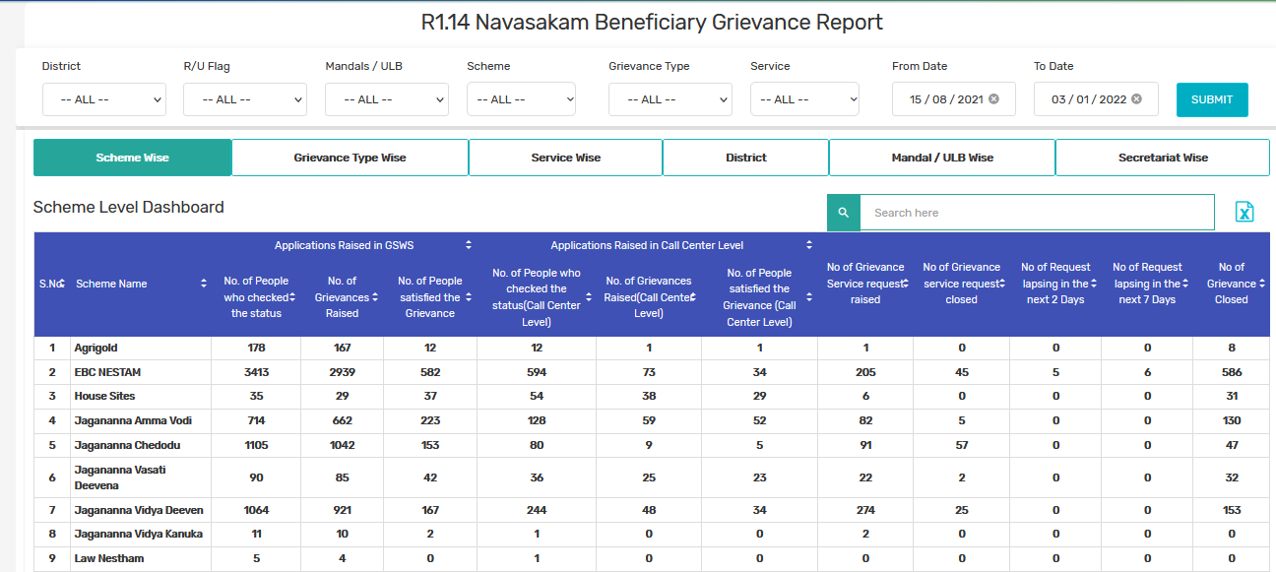
Grievance Redressal Monitoring
Dashboard has be designed to review/track the status of grievances
Access has been provided to All the District Collector/HoD’s to review the progress with concerned officers

